Slide 1

Open Notebook Science NOW!
Peter Murray-Rust (Shuttleworth Fellow),
University of Cambridge
Honouring Jean-Claude Bradley,
Cambridge 2014-07-14
CC 0
Notes:
Hi, I’m here to talk about AMI; a data extraction framework and tool. First, I just want highlight some of key contributors to the projects; Andy for his work on the ChemistryVisitor and Peter for the overall architecture.
In this talk, I’m going to impress the importance of data in a specific format and its utility to automated machine processing. Then I’m going to demonstrate AMI’s architecture and the transformation of data as it flows through the process. I’m going to dwell a little on a core format used, Scalable Vector Graphics (SVG) before introducing the concept of visitors, which are pluggable context specific data extractors. Next, I’m going to introduce Andy’s ChemVisitor, for extracting semantic chemistry data, along with a few other visitors that can process non-chemistry specific data. Finally, I will demonstrate some uses of the ChemVisitor, within the realm of validation and metabolism.

Slide 2
Overview*
Jean-Claude’s vision
Relation to Free/Open Source
The time has come; We can do it now
The combination of Truth and Community will change the way we do science
* Parts of talks recently given to EBI and also Austrian Science Fund (FWF)

Slide 3
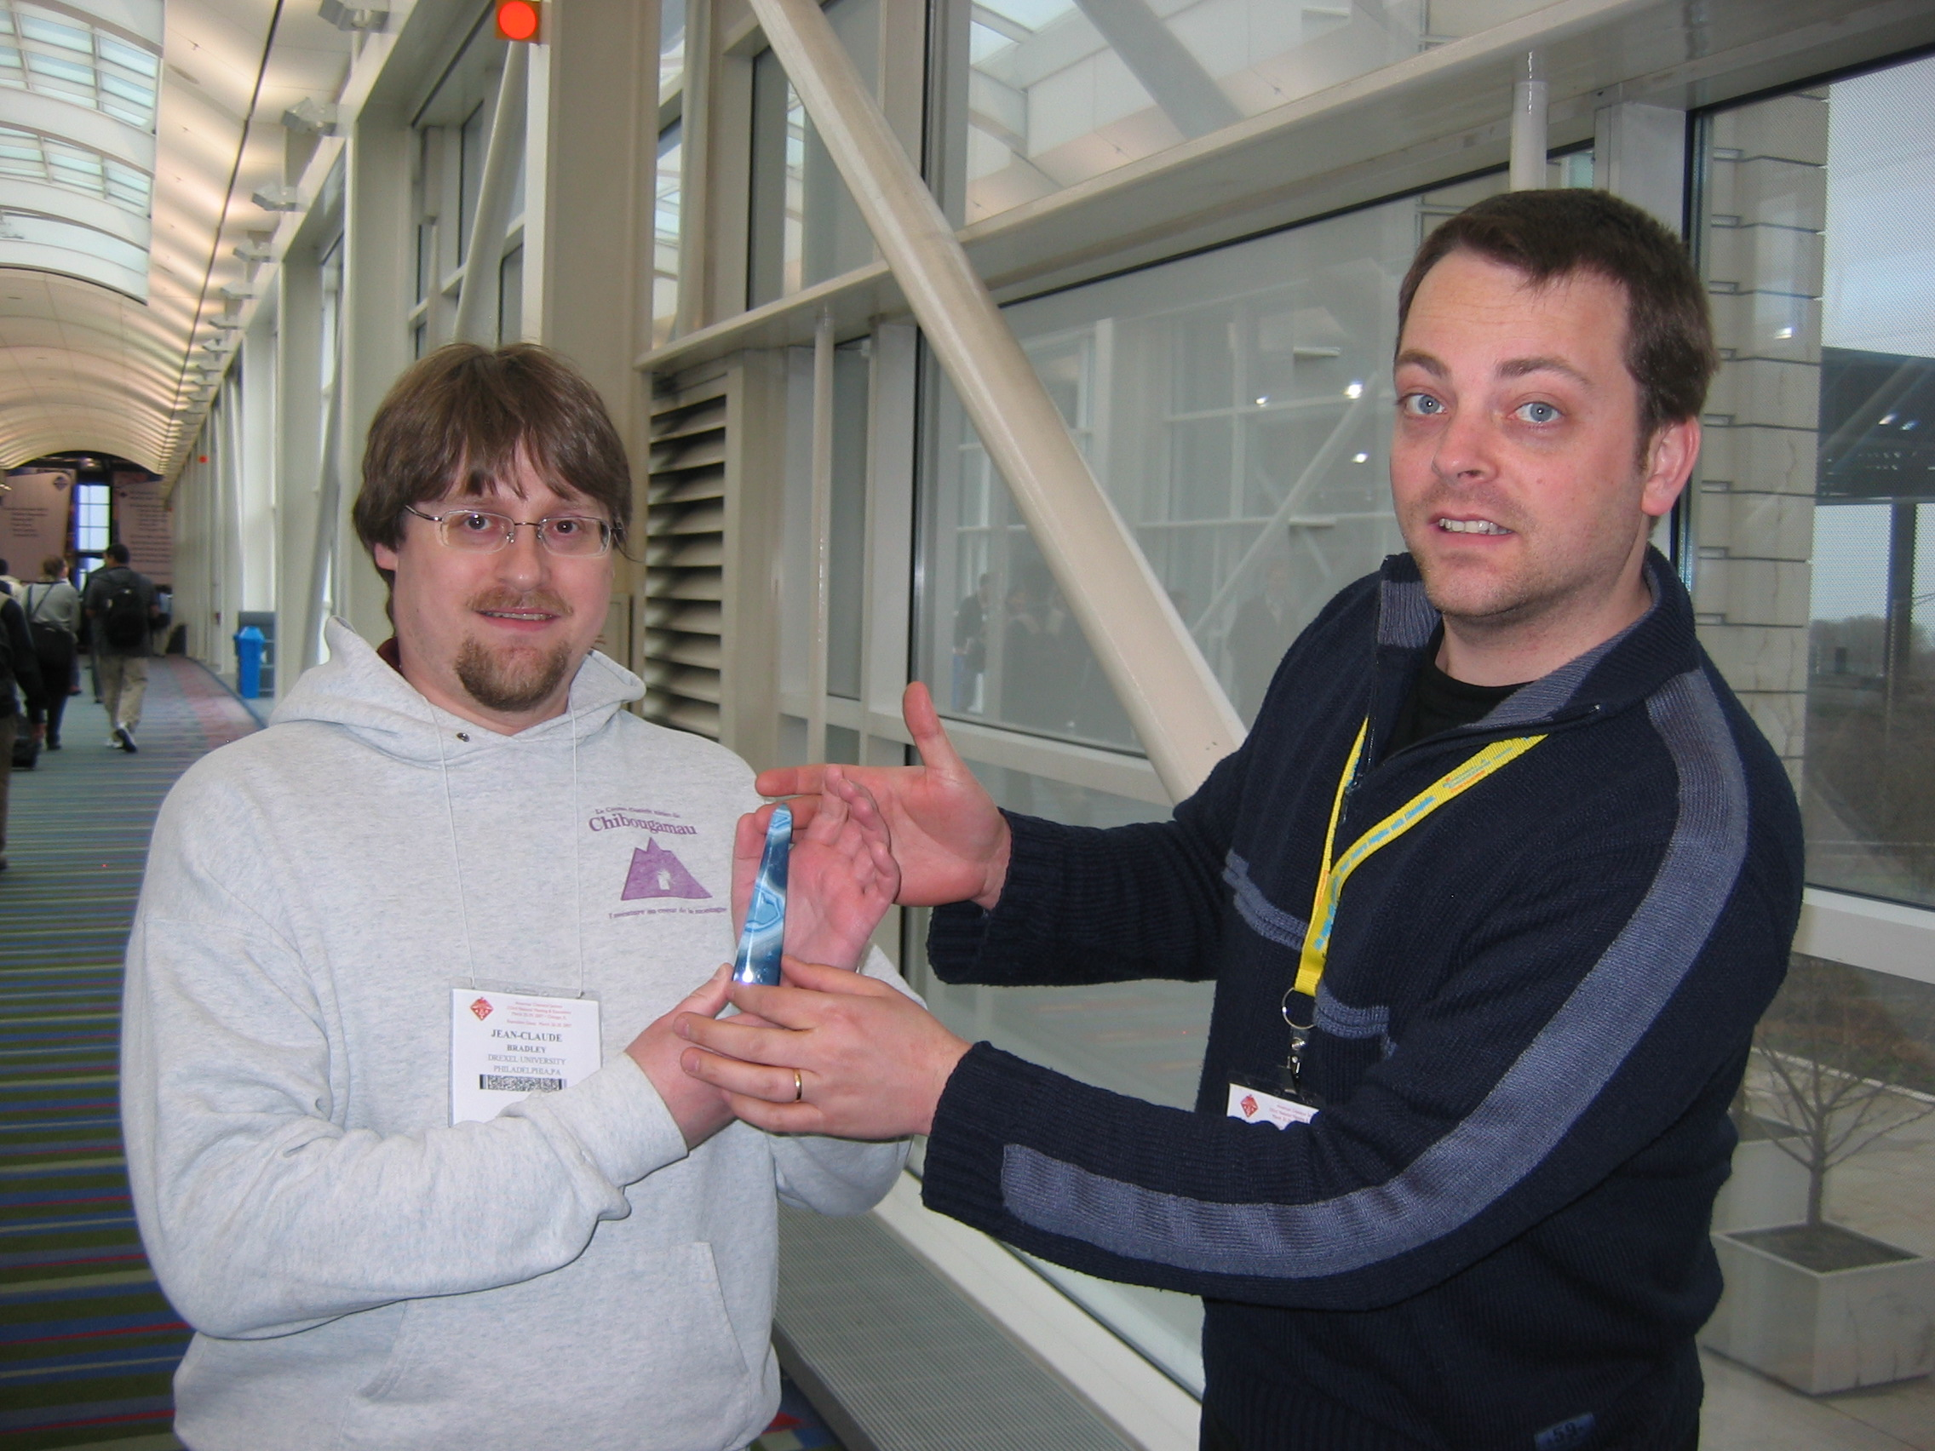
Award of Blue Obelisk
Jean-Claude Bradley
Egon Willighagen

Slide 4
Traditional Research and Publication
DATA
???
rewrite
“Lab” work
Write
paper/thesis
publish
Validation??
output often
seriously restricted
Re-experiment

Slide 5
Bad publication wastes science
…three problems—flawed design, non-publication, and poor reporting—together meant >85% of research funds were wasted, a global total loss >100 billion USD per year. [Lancet 2009]
[Even more] waste clearly occurs after publication: from poor access, poor dissemination, and poor uptake of the findings of research. [PLOS Medicine 2014-05-27]

Slide 6
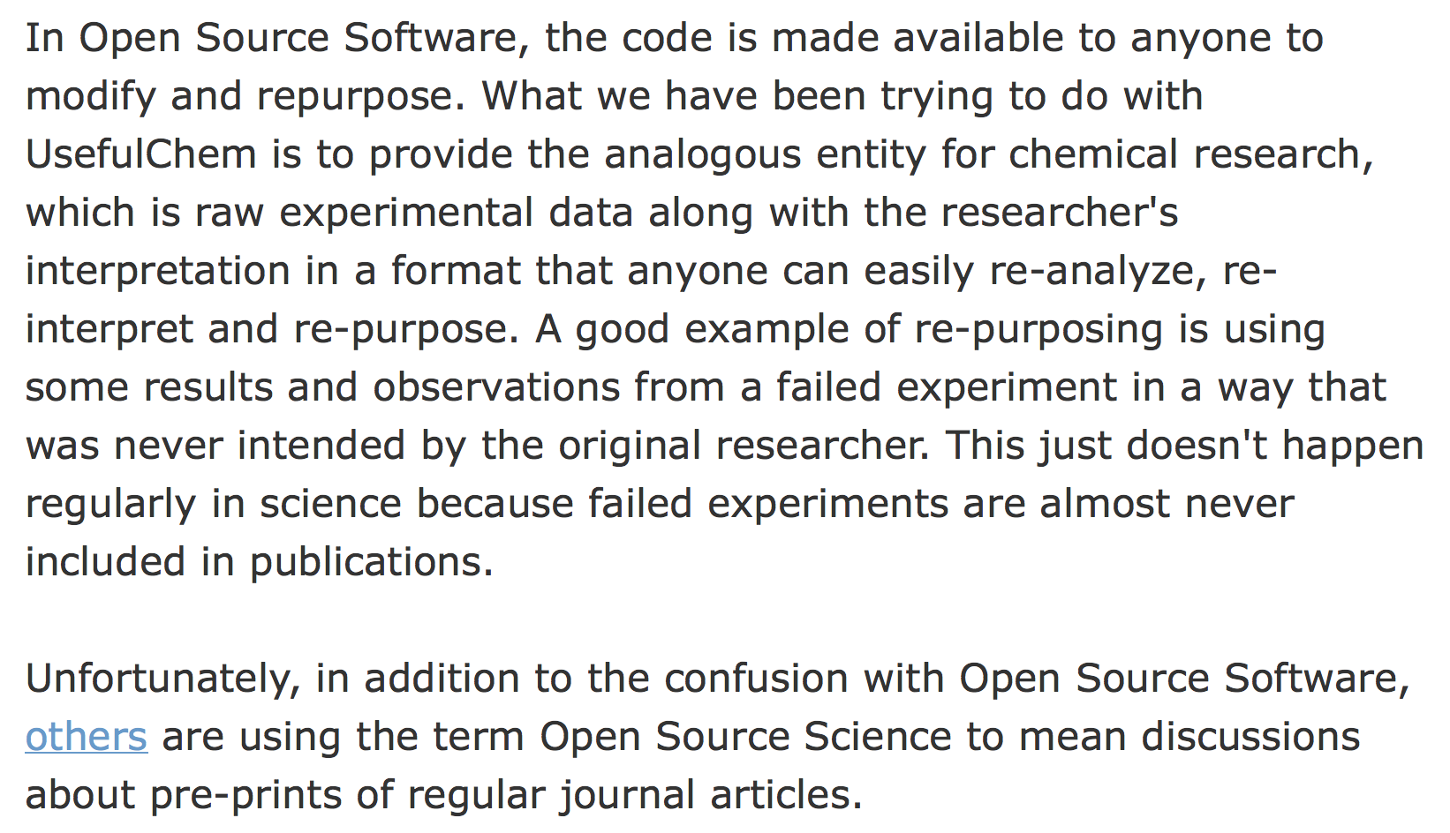
Open Source software inspires Open Science
Jean-Claude Bradley 2006

Slide 7
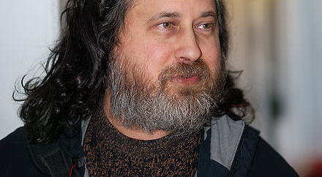
4 Freedoms (Richard Stallman)
0: The freedom to run the program for any purpose.
1: The freedom to study how the program works, and change it to make it do what you wish.
2: The freedom to redistribute copies so you can help your neighbor.
3: The freedom to improve the program, and release your improvements … to the public, so that the whole community benefits.

Slide 8
“Free” and “Open”
"Free software is a matter of liberty, not price. ’free speech', not 'free beer'”. (R M Stallman)
“A piece of data or content is open if anyone is free to use, reuse, and redistribute it” (OKFN)http://opendefinition.org/
“Gratis” vs “Libre”

Slide 9
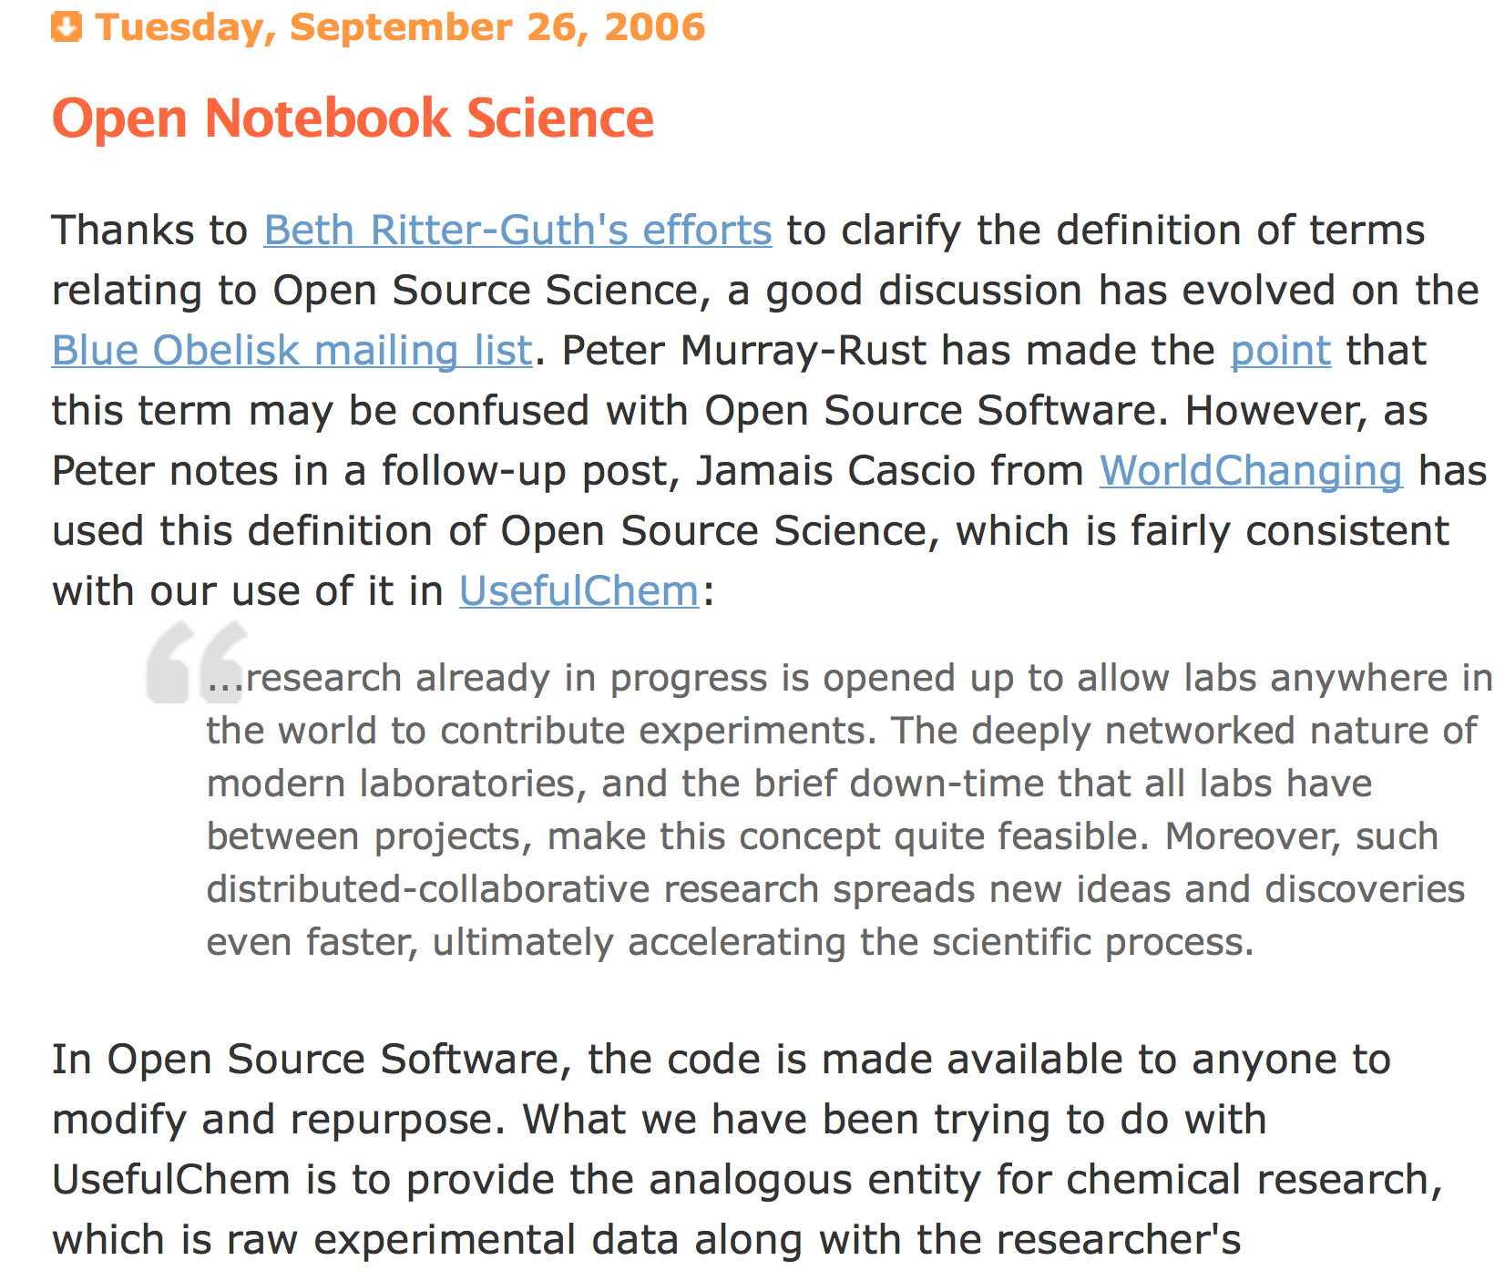

Slide 10
Free/Open Software Development
validate
Engineered repository
CODE
rewrite
fork
CODE
Re-use
inspires
Re-use
CODE
CODE
OSI
World
community
Github, BitBucket
StackOverflow,
Apache

Slide 11
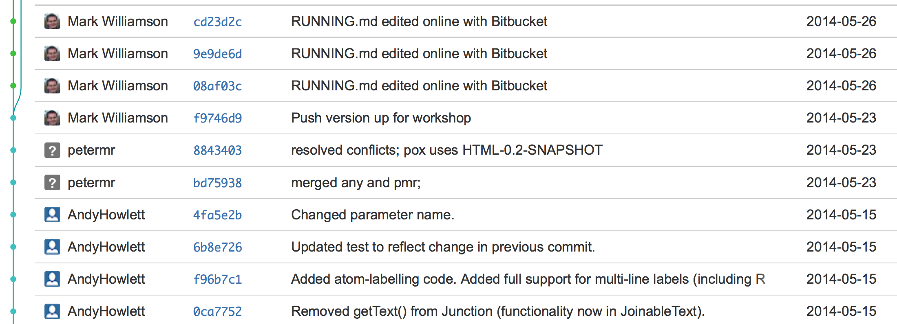
Software repos, Github and Bitbucket
Every operation fully captured AND VALIDATED
Multiple contributors, can fork and merge
Everything visible on web
https://bitbucket.org/petermr/xhtml2stm-dev/commits/all

Slide 12
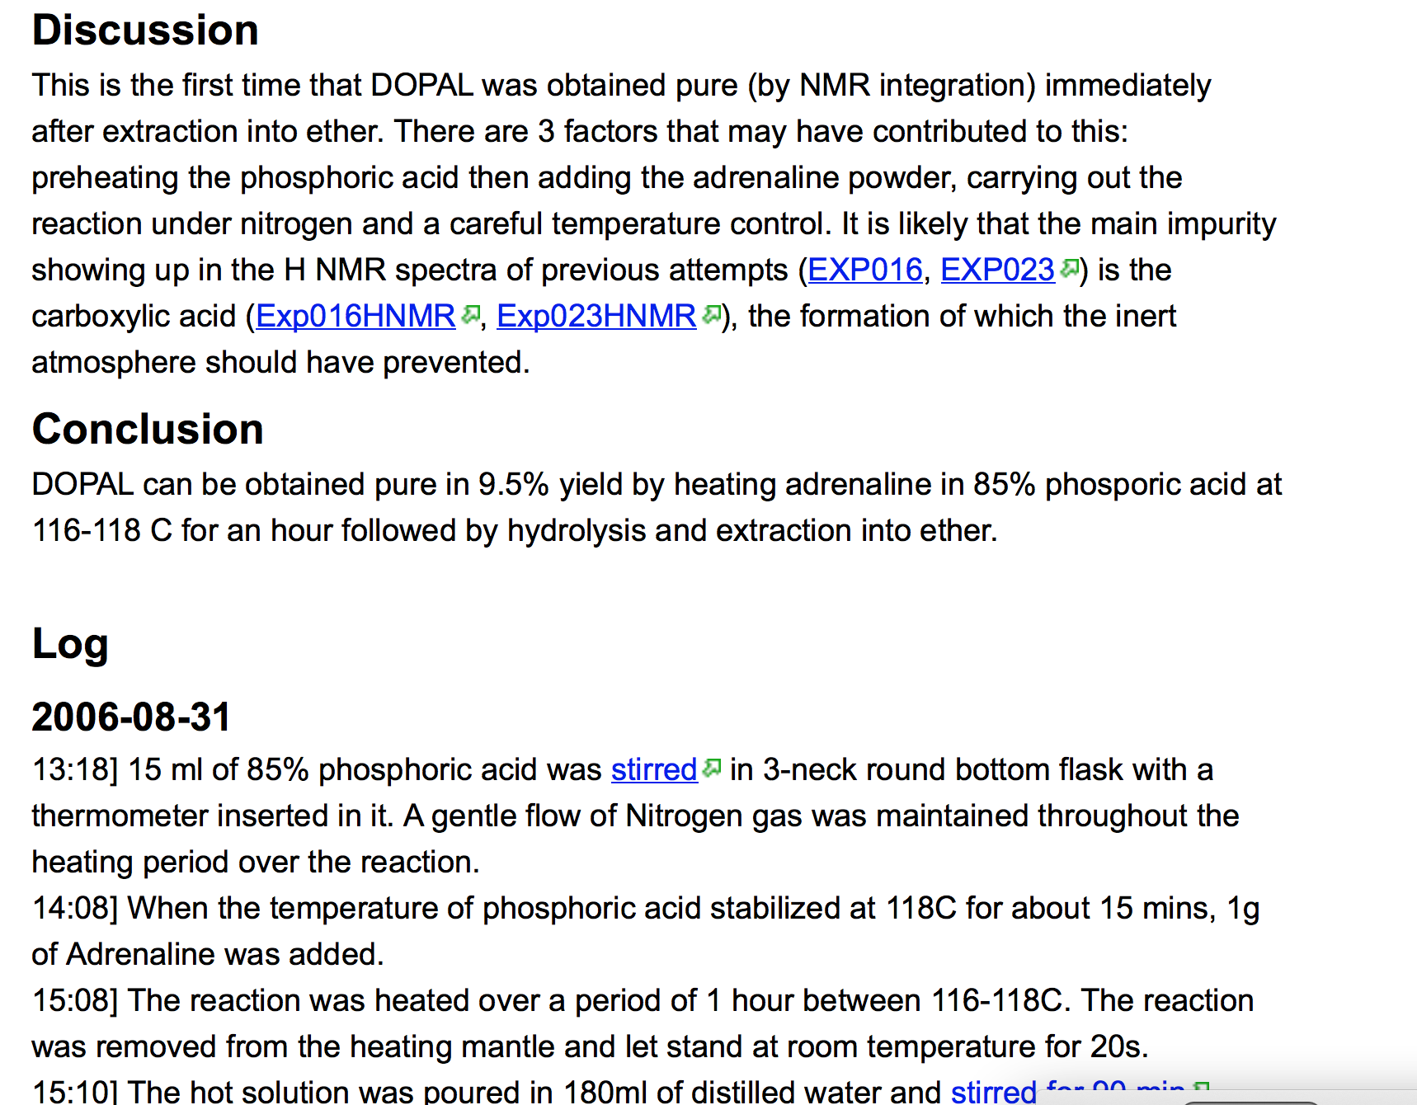
Jean-Claude Bradley 2006

Slide 13
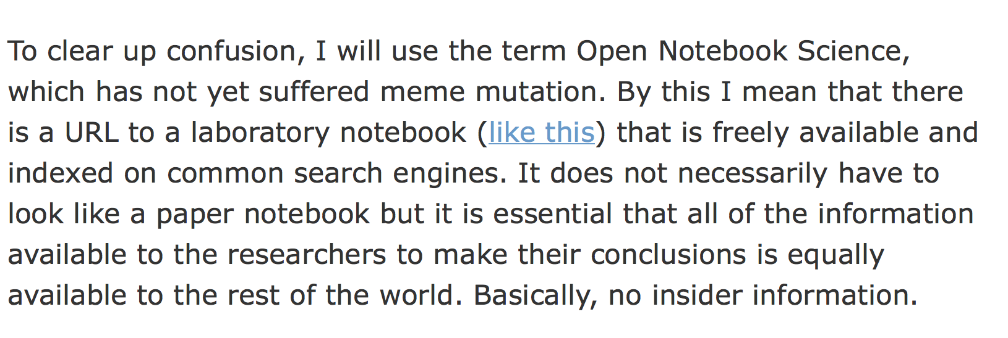
Open Notebook Science, ONS
Jean-Claude Bradley 2006

Slide 14
https://en.wikipedia.org/wiki/Bermuda_Principles
Automatic release of sequence assemblies larger than 1 kb (preferably within 24 hours).
Immediate publication of finished annotated sequences.
Aim to make the entire sequence freely available in the public domain for both research and development in order to maximise benefits to society.

Slide 15
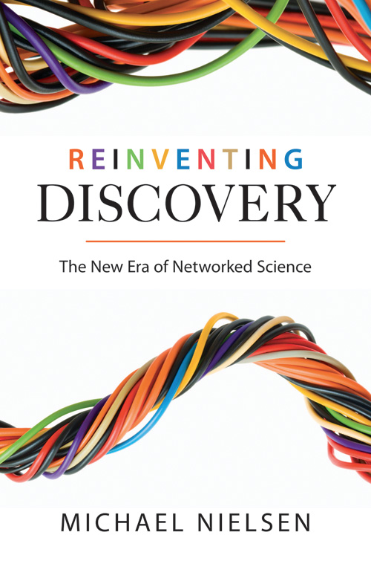

http://en.wikipedia.org/wiki/Reinventing_Discovery
http://michaelnielsen.org/blog/reinventing-discovery/

Slide 16
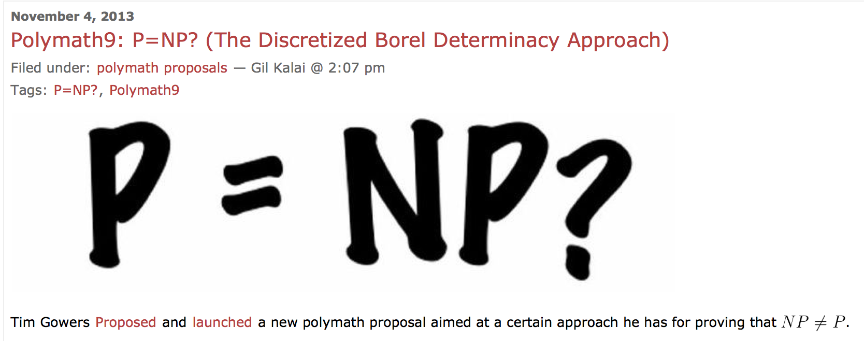
The Polymath project
Tim Gowers and the world
http://polymathprojects.org/2013/11/04/polymath9-pnp/#comments
http://gowers.wordpress.com/2013/11/03/dbd1-initial-post/

Slide 17
http://www.budapestopenaccessinitiative.org/read
… an unprecedented public good. …
… completely free and unrestricted access to [peer-reviewed literature] by all scientists, scholars, teachers, students, and other curious minds. …
…Removing access barriers to this literature will accelerate research, enrich education, share the learning of the rich with the poor and the poor with the rich, make this literature as useful as it can be, and lay the foundation for uniting humanity in a common intellectual conversation and quest for knowledge.
(Budapest Open Access Initiative, 2003)

Slide 18
Panton Principles for Open Data in science(2010)
PUBLISH YOUR DATA OPENLY
…make an explicit and robust statement of your wishes.
Use a recognized waiver or license that is appropriate for data.
open as defined by the Open Knowledge/Data Definition (… NOT non-commercial)
Explicit dedication of data … into the public domain via PDDL or CCZero
Peter Murray-Rust, Cameron Neylon, Rufus Pollock, John Wilbanks

Slide 19
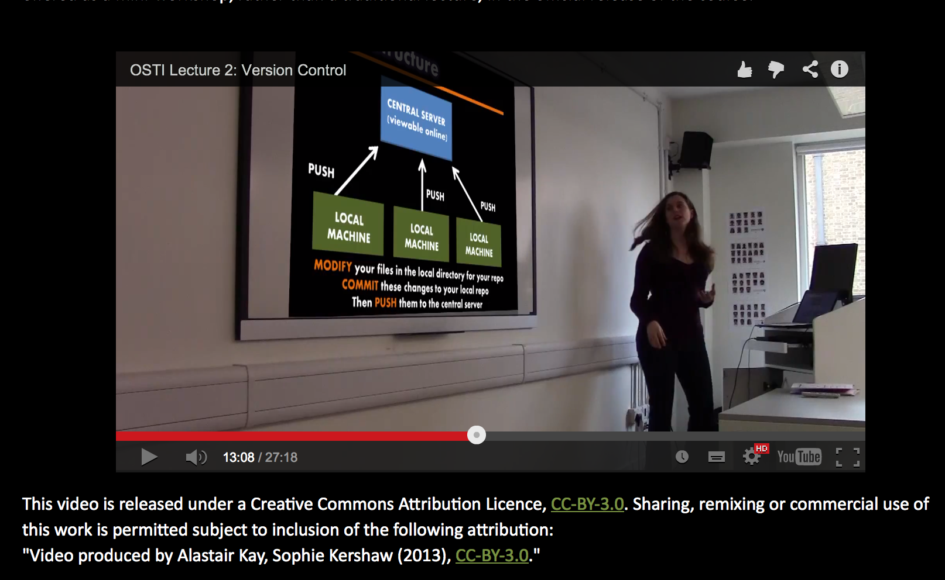
Sophie Kershaw, Panton Fellow

Slide 20
Open Notebook Science
TOOLS
Open engineered
repository
validate
DATA
INSTRUMENT
merge
knowledge
DATA
calibrate
MODEL
CODE
Machines and humans
Working together
World
community
Problems are solved communally;
Nothing is needlessly duplicated; “publication“ is continuous ; data are SEMANTIC

